Slide 1


Introduction to Data Communication
IE551
Spring 2004

Slide 2
DATA COMMUNICATION
• Need:
Design file exchange.
Part program downloading.
Person to person communication - e-mail, talk, video conferencing.
System control: commands, status data, sensor data
Remote login.
• 50% of plant floor computer system cost are allocated to networking costs.
• How to make control devices talk to each other.
• Solutions:
Point-to-point communication
Networking

Slide 3
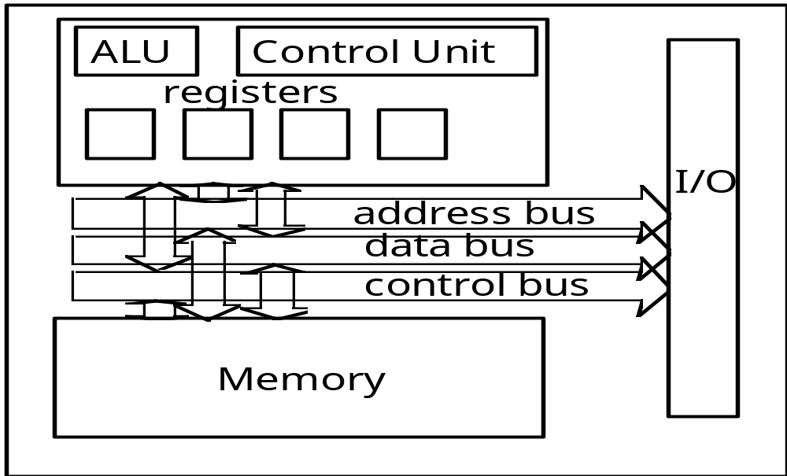
AN CPU

Slide 4
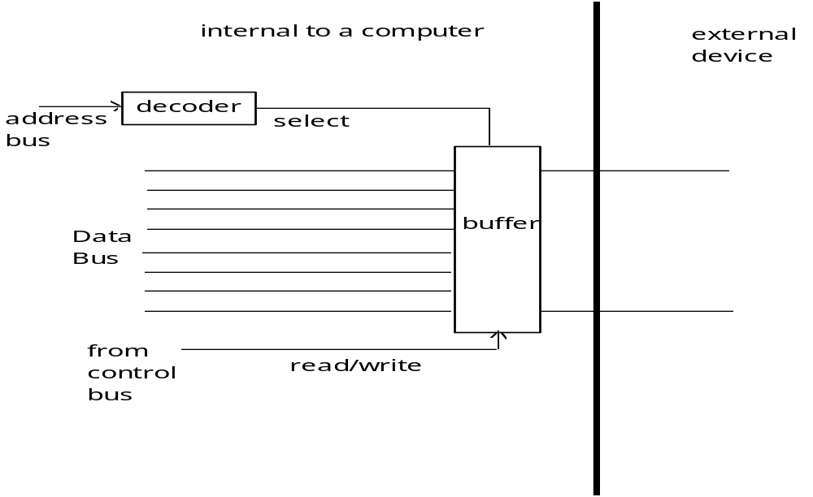
AN I/O BUFFER
clock

Slide 5
ASCII CODE
High Bits
low 000 001 010 011 100 101 110 111
0000 NUL DLE SP 0 @ P \ p
0001 SOH DC1 ! 1 A Q a q
0010 STX DC2 " 2 B R b r
0011 ETX DC3 # 3 C S c s
0100 EOT DC4 $ 4 D T d t
0101 ENQ NAK % 5 E U e u
0110 ACK SYN & 6 F V f v
0111 BEL ETB ' 7 G W g w
1000 BS CHN ( 8 H X h x
1001 HT EM ) 9 I Y i y
1010 LF SUB * : J Z j z
1011 VT ESC + ; K [ k {
1100 FF FS , < L \ l |
1101 CR GS - = M ] m }
1110 SO RS . > N ^ n ~
1111 SI US / ? O _ o DE

Slide 6
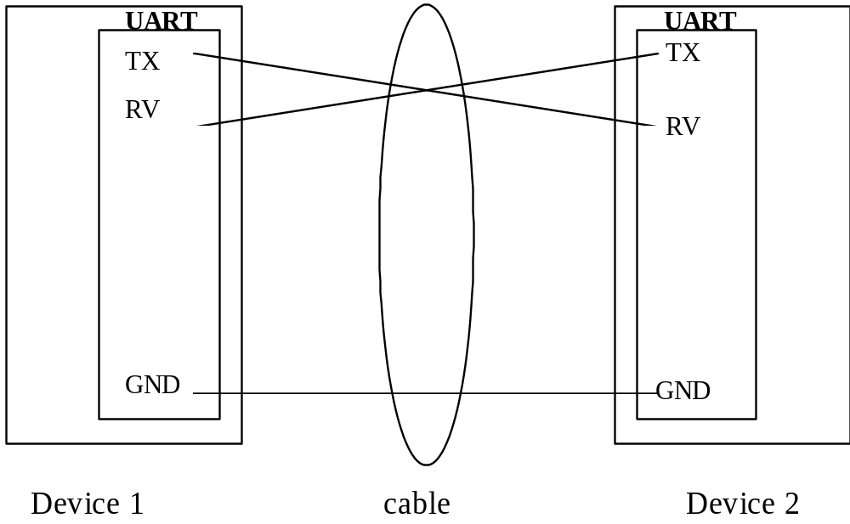
SERIAL COMMUNICATION
parallel
DTE
DCE

Slide 7
INTERFACE
DTE: Data Terminal Equipment (terminal)
DCE: Data Circuit-terminating Equipment (modem, computer)
DTE
DCE
DCE
DTE
RS 232C, RS 422, X.21
RS232C 25 pin connector
DB25 connector
1 < -3V
0 > 3V
< 20 kbps
< 15 m
unbalanced signal
RS 422 37 pin or 9 pin
twisted pair balanced
100 kbps at 1200m
10 mbps at 12 m
or unbalanced (RS 423A)
3 kbps at 1000 m
300 kbps at 10 m
X.21
packet transmission mode

Slide 8
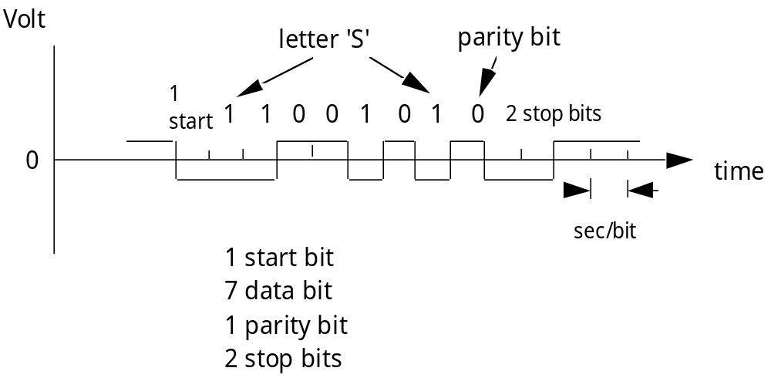
TRANSMITTING THE LETTER 'S'
Even parity
Baud rate = 1/ clock

Slide 9
RS 232
PIN NAME <TO DTE TO DCE> FUNCTION EIA CCITT
FG Frame Ground AA 101
TD > Transmitted Data BA 103
RD < Receive Data BB 104
RTS > Request to Send CA 105
CTS < Clear to Send CB 106
DSR < Data Set Ready CC 107
SG Signal Ground AB 102
CD < Carrier Detect CF 109
- Reserved - -
10 - Reserved - -
11 - Unassigned - -
12 (S)CD < Sec. Carrier Detect SCF 122
13 (S)CTS < Sec. Clear to Send SCB 121
14 (S)TD > Sec. Transmitted Data SBA 118
15 TC < Transmitter Clock DB 114
16 (S)RD < Sec. Received Data SBB 119
17 RC < Receiver Clock DD 115
18 - Unassigned - -
19 (S)RTS > Sec. Request to send SCA 120
20 DTR > Data Terminal Ready CD 108.2
21 SO < Signal Quality Detector CG 110
22 RI < Ring Indicator CE 125
23 > Data Rate Selector CH 111
Data Rate Selector CI 112
24 (E)TC > Ext. Transmitter Clock DA 113
25 - Unassigned - -

Slide 10
MODEM STANDARDS
CCITT V.XX standards (Consultative Committee for International Telephone and Telegraph)
V.22, V.22 bis. : synchronous/asynchronous data transmission, full-duplex operation over 2 wire at 1,200 bps (2,400 and 1,200 bps for V.22 bis) data rate.
V.32 : synchronous/asynchronous data transmission, full-duplex operation over 2 wire at 9,600 bps data rate.
V.32 bis: synchronous/asynchronous data transmission, full-duplex operation over 2 wire at 14,400, 12,000, 9,600, 7,200, 4,800 bps data rate.
V.34 bis: synchronous/asynchronous data transmission, full-duplex operation over 2 wire at 28.8k, ...
Modem-connection negotiations (training and retraining), may reduce the data rate due to line noise. Fastrain: may go up the speed as well.
Duplex: full (two lines, two way), half (one line, one way)
Bell standard: Bell 103, 300 bps; Bell 201B: 2,400 bps, full duplex on 4 wire, or 1,200 bps, half duplex on 2 wire. Bell 201C: 2,400 bps, half duplex on 2 wire; Bell 208 A & B: 4,800 bps
Data compression: compress the data before transmission.

Slide 11
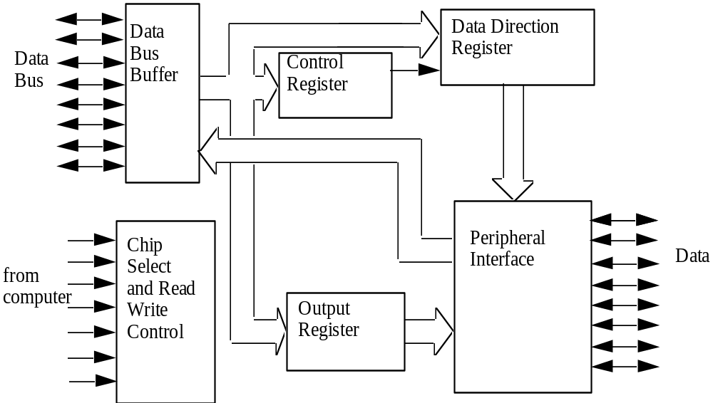
PARALLEL INTERFACE ADAPTER
address
decoder
enable

Slide 12
IEEE 488
Standard digital interface for programmable instrumentation
HP interface
GPIB (General Purpose Interface Bus)
1 mbps

Slide 13
POLLING
s
t
a
t
u
s
y
e
s
o
f
i
n
p
u
t
p
o
r
t
n
o
l
o
a
d
i
n
p
u
t
b
y
t
e
t
o
l
o
o
p
t
h
e
a
c
c
u
m
u
l
a
t
o
r
s
t
a
t
u
s
y
e
s
o
f
o
u
t
p
u
t
p
o
r
t
n
o
s
e
n
d
a
b
y
t
e
t
o
t
h
e
o
u
t
p
u
t
p
o
r
t

Slide 14
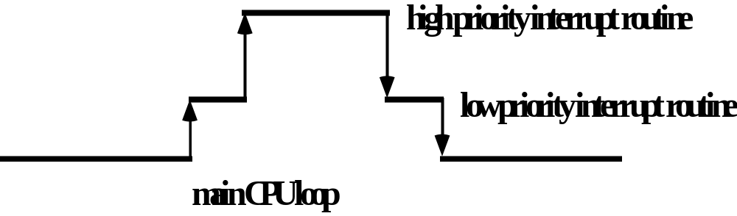
INTERRUPT

Slide 15
NETWORKS
No longer a point-to-point connection.
Many devices connected together and information can be passed by one device to any of the devices on the network.
Local area network - Ethernet, FDDI, ATM
Wide area network
High speed local network

Slide 16
COMPARISON
LAN High Speed Local Computerized Branch
Network (HSLN) Exchange (CBX)
Transmission medium Twisted pair
Coaxial cable
Optical fiber CATV coax Twisted pair
Topology bus, tree, ring bus star
Speed 1-20 Mbps 50 Mbps 9.6-64 Kbps
Max Distance 25 Km 1 Km 1 Km
Switching Technique Packet Packet Circuit (no delay)
No. of Devices
Supported 100's - 1000's 10's 100's-1000's
Attachment Cost low high very low
Applications Computers Main frame to Voice
Terminals disk drive Terminal-t-terminal
Terminal-t-host

Slide 17
GLOSSARY OF SELECTED TERMS
Bandwidth: frequency range used by the communication system.
Baseband: use voltage difference (digital)
Broadband: use coaxial cable and analog (RF) signals. Higher band width, multiple channels on the same cable. Digital signals are modulated on a carrier frequency.
CTV: 5 mbps per channel
Carrier from 5-300 M Hz
Carrier: A continuous frequency capable of being modulated or impressed with a second (information) signal.
DDS (Dataphone Digital Service): AT&T service in which data is transmitted in digital rather than analog form. Need no modem.
FDDI (Fiber Distributed Data Interface): ANSI standard for fiberoptic links with data rates up to 100 mbps. LED or laser light source; 2 km for unrepeated data transmission at 40 mbps.
ISDN (Integrated Services Digital Network): mixed digital-transmission services, basic rate at 144 kbps, and primary rates at 1.544 and 2.048 mbps.

Slide 18
GLOSSARY OF SELECTED TERMS
Medium Access Control: controls which device on the network get the to send data to the medium.
CSMA/CD
Token Ring
Token Bus
Packet: small chunk of data.
Protocol: a set of rules that governs the operation of functional units to achieve communication.
TCP/IP: Transport protocols concurrently with existing Ethernet.
NFS: network file system - file system sharing, remote disk mounting.

Slide 19
IDEAL LAN CHARACTERISTICS
• high speed: greater than 10 mega bits per second
• low cost: easily affordable on a microcomputer and/or
machine controller
• high reliability/integrity: low error rates, fault tolerant, reliable
• expandability: easily expandable to install new nodes
• installation flexibility: easy to be installed in an existing environment
• interface standard: standard interface across a range of computers
and controllers.

Slide 20
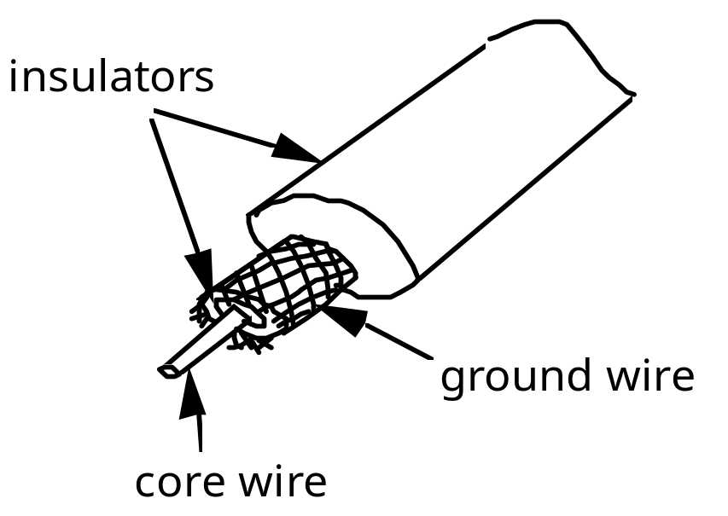
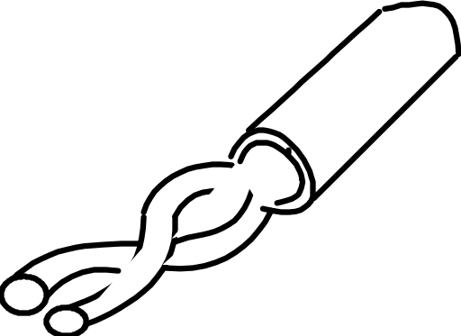
CABLES
Coaxial cable
Twist pair cable

Slide 21
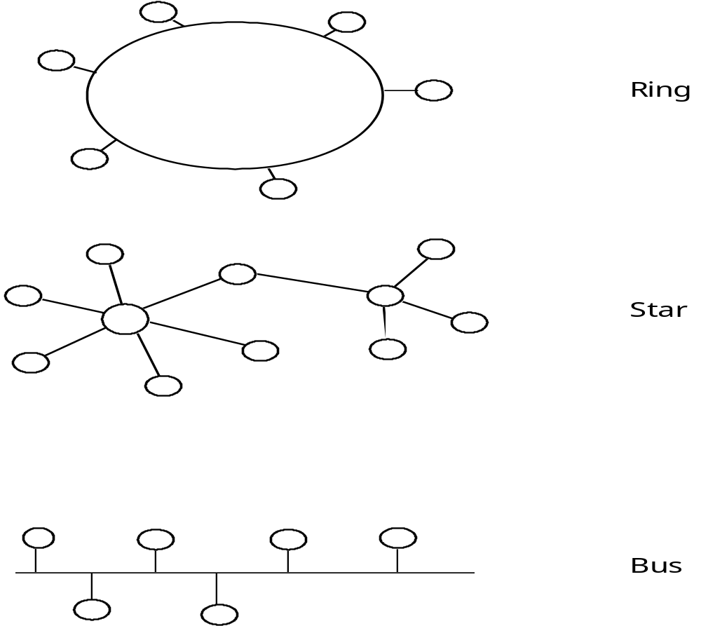
LAN TOPOLOGIES

Slide 22
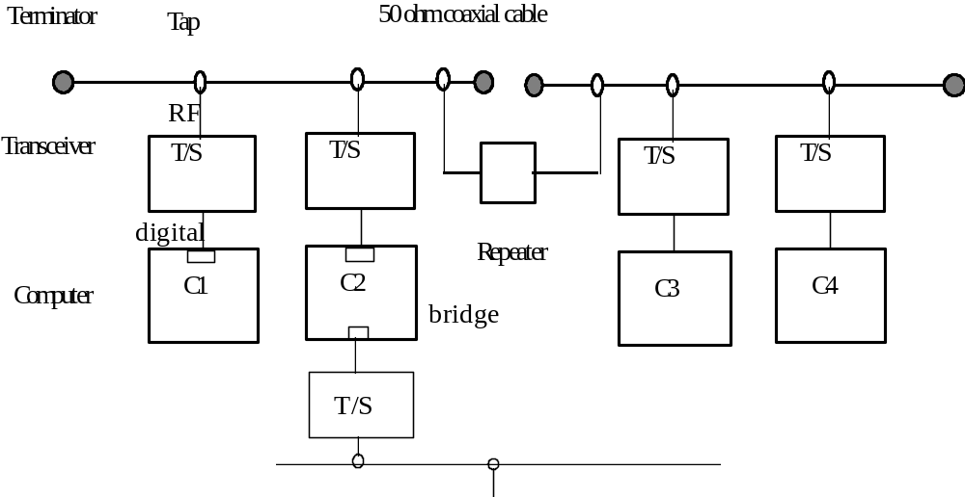
ETHERNET

Slide 23
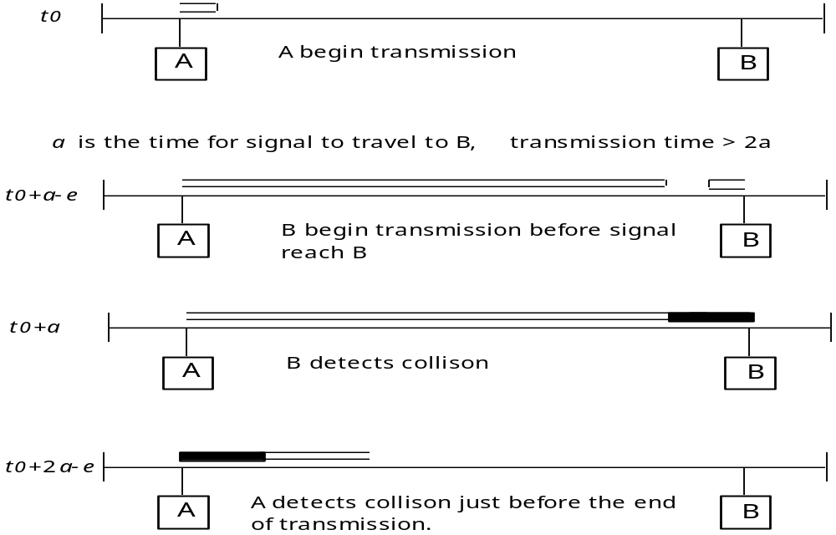
COLLISION DETECTION
CSMA/CD protocol

Slide 24
ETHERNET CONNECTIONS
Standard Ethernet (10BASE5)
• segment length Š 500 m
• cable Š 4 km
• transceiver cable Š 50 m
• between transceivers Š 2.5 m
• Š 100 transceivers per segment
• 50 ohm terminators
ThinNet Ethernet (10BASE2)
• segment length Š 185 m
• cable length Š 4 km
• T-connectors, 0.5 m between each
• Š 30 connections
• 50 ohm terminators
• T-connectors plugged directly to the Ethernet card.
Twisted-pair Ethernet (10BASE-T)
• segment length Š 100 m
• unshielded twisted-pair cable
• devices connected to a hub in a star configuration
• Hub connected to the standard Ethernet
• Use twisted-pair transceiver.
computers
T-connector
Hub
computers

Slide 25
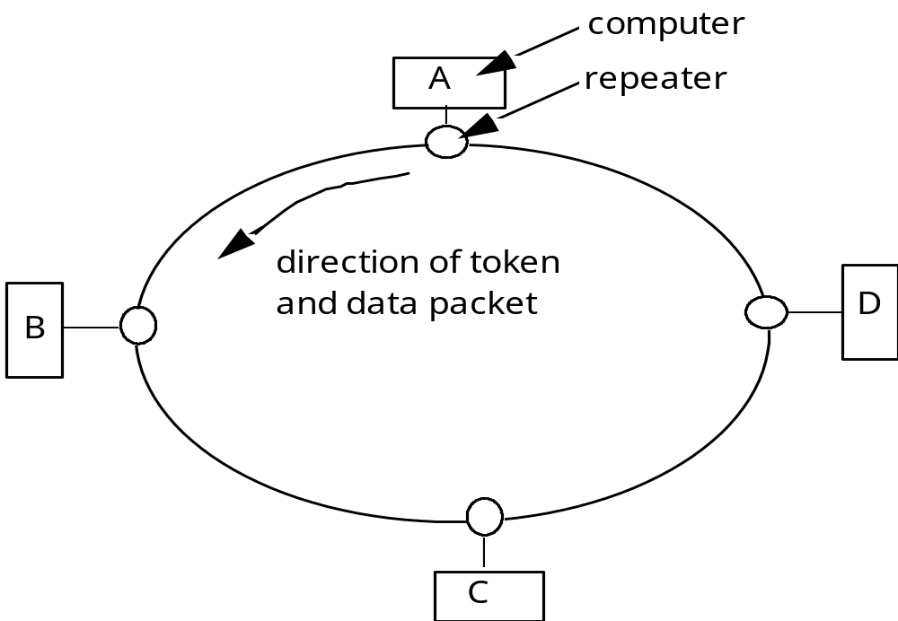
A TOKEN RING
Only one token is passed around the network.
The device who has the token may transmit.

Slide 26
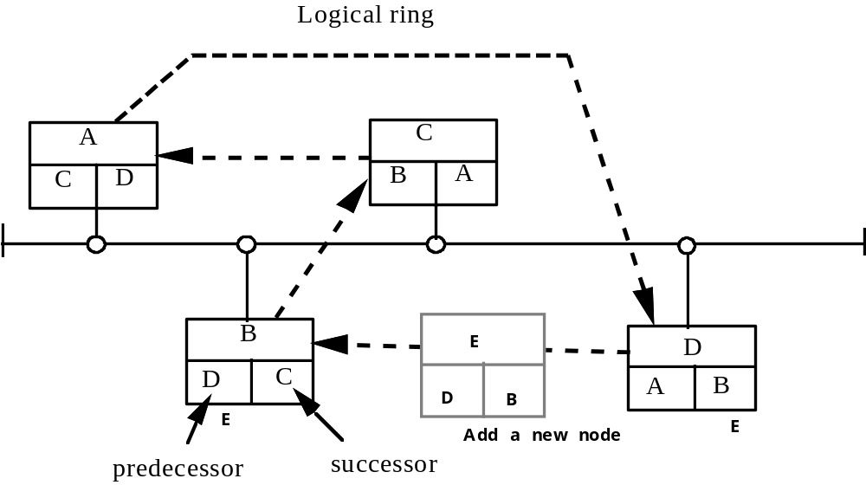
A TOKEN BUS
Token passing network. Whoever has the token may transmit one or
more packets. When it is done, or the time has expired, it passes the
token to the next station.

Slide 27
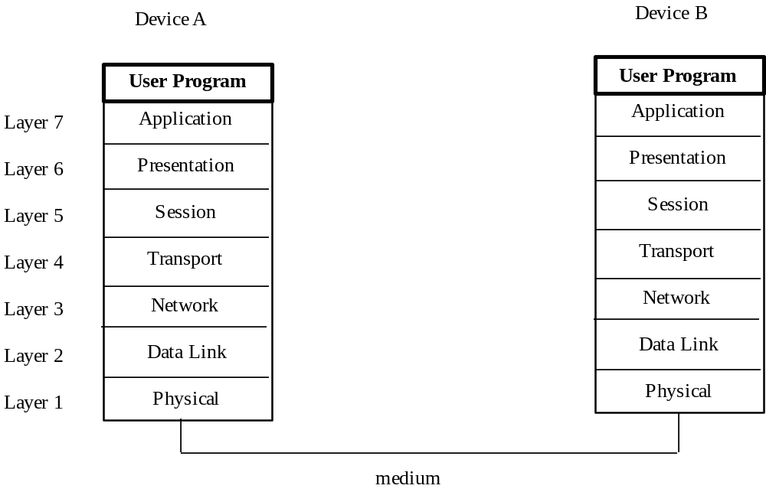
ISO/OSI MODEL

Slide 28
LAYERED PROTOCOL
2. DATA LINK LAYER
• flow control
• error control
Activate, maintain and deactivate the link. Error free transmission on the same network. Detecting noise.
3. NETWORK LAYER
provides the transparent transfer of data between transport entities. Responsible for establishing, maintaining, and terminating connections (between networks). Use globally unique node address.
4. TRANSPORT LAYER
Ensures that data units are delivered error-free, in sequence, without no losses or duplications.
Connection management

Slide 29
LAYERED PROTOCOL
5. SESSION LAYER
Controlling the dialogue between applications.
Dialogue type: two-way simultaneous (TWS), two-way alternate (TWA), one-way, etc.
Recovery after network breakage.
6. PRESENTATION LAYER
Syntax of the data exchanged between application entities.
e.g. teletext, videotex, encryption, virtual terminal.
7. APPLICATION LAYER
Common application services (CASE)
Specific application services (SASE)
Management
file transfer
job transfer

Slide 30
A PACKET
Preamble
Physical layer message
Data link layer message
Network layer message
Transport layer message
Session layer message
Presentation layer message
Application layer message
Data
Checksum
Postamble
SYN code
SYN code

Slide 31
MAP 2.1 STANDARD
Layer MAP implementation
Layer 7 ISO FTAM {DP} 8571
Application File Transfer Protocol
Manufacturing Messaging Format Standard (MMFS)
MAP Directory Services
MAP Network Management
Layer 6
Presentation NULL/MAP transfer
Layer 5 ISO Session{IS} 8327
Session Basic Combined Subset & Session Kernel, Full Duplex
Layer 4
Transport ISO Transport{IS} 8073
Class 4
Layer 3 ISO Internet{DIS} 8473
Network Connectionless, SubNetwork Dependent Convergence Protocol
Layer 2 ISO Logical Link Control {DIS} 8802/2 (IEEE 802.2)
Data Link Type 1, Class 1
ISO/IEEE 802.4 Token Passing Bus Medium Access Control
Layer 1 ISO Token Passing Bus{DIS} 8802/4 (IEEE 802.4)
Physical 10 Mbps Broadband

Slide 32
ROUTER
INTERNET
network
layer
network
layer
network
layer
data
link
data
link
data
link
physical
layer
physical
layer
physical
layer
Network A
Network B
Network C

Slide 33
An Integrated Corporate
Communication Network
Corporate
Finance/accounting
Office
Gateway
TOP network
IBM
Corporate
Gateway
SNA network
Ethernet
Bridge
Division
CAD/CAM
CRT
Corporate
TOP network
Offices
Factory
Gateway
CRT
Terminal
MAP
Data base
server
Backbone
Router
Robots
Office
Gateway
MAP
Machines
Sub Network
TOP network
PLCs
Gateway
PLCs
Robots
Vendor
Network

Slide 34
TOP
Technical Office Protocol: for the office network
Similar to MAP except the physical layer uses Ethernet 10Base5

Slide 35
COMMUNICATION ON UNIX
NETWORK INTERFACE LAYER
PROTOCOL LAYER
SOCKET LAYER
when a communication is desired, create a socket
get
protocol
Application
Protocol
IN buffer
Out buffer
e.g. ftp
telnet
out packet
Network
interface
Hardware
In packet
determines the route of travel

Slide 36
EXAMPLE
internet domain
for TCP protocol
s = socket(AF_INET, sock_stream,0); /* create a socket*/
connect(s,&server, sizeof(server)); /* establish connection */
write(s,buf,sizeof(buf)); /* send data */
close(s); /* close socket*/

Slide 37
TCP/IP PROTOCOL
U
s
e
r
P
r
o
g
r
a
m
A
p
p
l
i
c
a
t
i
o
L
n
a
y
e
r
7
U
D
P
F
T
P
P
r
e
s
e
n
t
a
t
i
o
L
n
a
y
e
r
6
S
M
T
P
T
E
L
N
E
S
T
e
s
s
i
o
L
n
a
y
e
r
5
T
r
a
n
s
p
o
r
L
t
a
y
e
r
4
T
C
P
N
e
t
w
o
r
L
k
a
y
e
r
3
I
P
D
a
t
a
L
i
n
L
k
a
y
e
r
2
E
T
H
E
R
N
E
T
P
h
y
s
i
c
a
L
l
a
y
e
r
1
UDP: User datagram protocol
FTP: File transfer protocol
SMTP: Simple mail transfer protocol
TELNET: Virtual terminal protocol
TCP: Transmission control protocol
IP: Internetwork protocol

Slide 38
DATA COMMUNICATION
AND INTERNET
CO
TERMINAL
TCP/IP
COMPUTER
LAN
COMPUTER
PC/MAC
COMPUTER
NY
COMPUTER
UUCP
PC/MAC
Phone line
TCP/IP
COMPUTER
COMPUTER
Ethernet
IN
modem
TERMINAL
PC/MAC

Slide 39
WHAT DO WE WANT
• SEND AND RECEIVE ELECTRONIC MAIL
• TRANSFER DATA
• REMOTE LOG IN OTHER COMPUTERS
• ACCESS INFORMATION RESOURCES IN THE WORLD
• COMMUNICATE WITH PEOPLE OF COMMON INTEREST
• RETRIEVE AND ARCHIVE DATA AND APPLICATION PROGRAMS
• OPEN TO THE INFORMATION DATA HIGHWAY

Slide 40
DATA COMMUNICATION
ALTERNATIVES
• Phone and fax
• BBS (bulletin board system) run your own.
• Commercial information vendors: CompuServe, Prodigy, America Online, GEnie
• Internet connection

Slide 41
COMPUTER NETWORK
Domains
Information Vendor
EDU
GOV
MIL
COM
NET
ORG
TW - Taiwan
CU - Cuba
CA - Canada
FR - France
JP - Japan
IR - Iran
IQ - Iraq
...
America Online
GEnie
Prodigy
CompuServe
MS Network
Internet
References:
Krol, E., the Whole Internet User's Guide & Catalog, O'Reilly & Associates, Inc., 1992, 376 pages. ($24.99, 1-800-998-9938, nuts@ora.com)
Hahn, H. & R. Stout, The Internet Complete Reference, Osborne McGraw-Hill, 1994. 817 pages.

Slide 42
WHAT IS INTERNET?
Internet is a loosely connected wide area network. It is a group of worldwide information resources open to everyone on the network. Some characteristics of the internet:
• Origin: Arpanet sponsored by US DOD in the 1970s.
• Who may participate? Anyone who pays a nominal fee to connect to a nearby network and agrees to follow a set of rules.
• Who runs the network? Nobody is in charge.
• Who pays for it and to whom? The organization who is connected to the network must pay it own segment of the network. There is no central organization to collect the payment.
• What kind of hardware is needed to run the network? Any kind of computer hardware.
• How to connect to a network? Find a closest node and negotiate the connection.
• What is the limitation of using it? No direct commercial use.
• What is most widely used operating system on the net? Unix.
• How big is the network? Too big and growing to be even bigger every minute.

Slide 43
COMMONLY AVAILABLE TOOLS
ON INTERNET
• TCP/IP: The network protocol used on the net. Packet switching and mail gram. Each computer on the net is assigned a unique IP address, e.g. 128.54.16.1. DNS domain name system does translation between names and the IP address.
• E-MAIL: tchang@ecn.purdue.edu
userid @ machine. local_domain. domain
• Telnet: remote login a terminal session on an UNIX machine.
• Ftp: remote file copying.
• Usenet: news/discussion groups. Top cover from ethnic politics to science fiction.
• Archie: archive software and articles. Archie servers provide index of information available on public archives.
• Gopher, Veronic, and Jughead:
easier way to explore internet resources.
• Wais: information search on the internet.
• Finger: look up someone on the net.
• Talk talk to someone on the net (two way communication).

Slide 44
WORLD WIDE WEB
(WWW)
HyperText interface to the Internet. Allows users to explore the network effortlessly. Developed at CERN, the particle physics institute in Geneva Switzerland.
HTTP: HyperText Transfer Protocol
URL: Uniform Resource Locator "http://www.ecn.purdue.edu"
HTML: HyperText Markup Language
VRML: Virtual Reality Markup Language
Client/Server: client is a software application that extract service from a server.
Home Page: A start-up document that serves as your home base.
Tools (Browsers):
Lynx : for text terminal
Mosaic: graphics, Mac Mosaic, PC Mosaic, X- Mosaic (NCSA product),
Netscape, etc.

